Slide 1
Model View PRESENTER (MVP)
WorkShop Equipo R

Slide 2
Necesidad Separar
Acoplamiento entre datos y vista: CursorAdapters, ASyncTasks dentro de Activities o Fragments
Claridad en el código, mantenibilidad
Como parte de una arquitectura para las aplicaciones Android
Responsabilidades

Slide 3
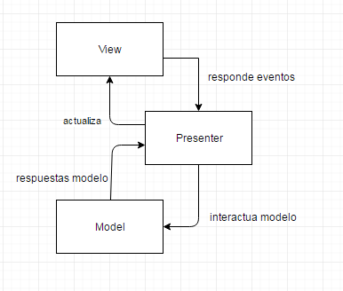
Que es MVP?
Patrón para la capa de presentación
Permite separar la capa de presentación de la lógica

Slide 4
Implementación android
public interface LoginView {
void showProgress();
void hideProgress();
void showMessage(String message);
}
public interface Presenter {
void onResume();
void onPause();
void onDestroy();
}

Slide 5
Implementación Android
public class LoginPresenter {
private LoginView loginView;
public LoginPresenter(){}
public void setView(@NonNull LoginView loginView) {
this.loginView = loginView;
}
public void doLogin(String user, String pass){
loginView.showProgress();
performLogin(user, pass);
}
void onResume(){
if (loginView != null) {
loginView.showProgress();
}
}
void onPause(){}
}
private void performLogin(String user, String pass){
AsyncTask<String, Void, String> doLoginTask = new AsyncTask<String, Void, String>() {
@Override
protected void onPreExecute() {
super.onPreExecute();
loginView.showProgress();
}
@Override
protected String doInBackground(String... params) {
String user = params[0];
String password = params[1];
try {
Thread.sleep(3000);
} catch (InterruptedException e) {
e.printStackTrace();
}
return "Login Ok!!!";
}
@Override
protected void onPostExecute(String message) {
super.onPostExecute(message);
loginView.hideProgress();
loginView.showMessage(message);
}
};
doLoginTask.execute(user, pass);
}

Slide 6
Implementación Android
public class LinearLayoutActivity extends AppCompatActivity implements LoginView{
private LoginPresenter loginPresenter;
@Override
public void showProgress() {
if(progressBar!=null){
progressBar.setVisibility(View.VISIBLE);
}
}
@Override
public void hideProgress() {
if(progressBar!=null){
progressBar.setVisibility(View.GONE);
}
}
@Override
public void showMessage(String message) {
Toast toastMessage = Toast
.makeText(this, message, Toast.LENGTH_LONG);
toastMessage.show();
}
}

Slide 7
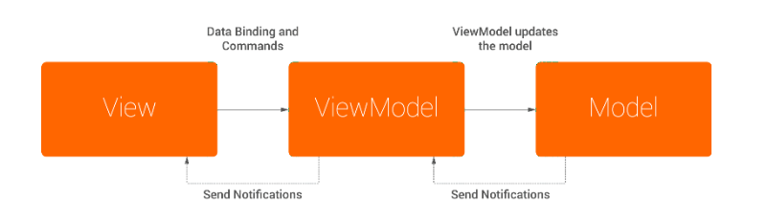
Model View view model (MVVM)

Slide 8
Referencias
https://github.com/konmik/konmik.github.io/wiki/Introduction-to-Model-View-Presenter-on-Android
https://github.com/pedrovgs/EffectiveAndroidUI
http://antonioleiva.com/mvp-android/

